Slide 1
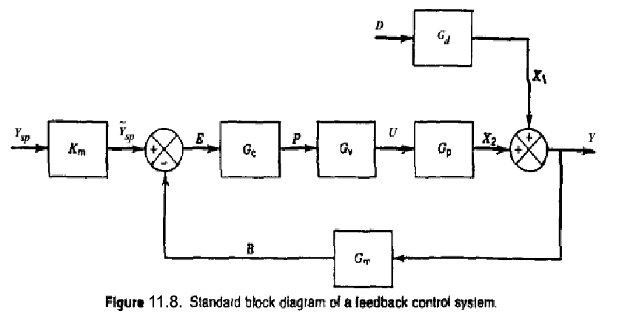
Dynamic Behavior of Closed-Loop Control Systems
4-20 mA
Chapter 11

Slide 2
Chapter 11

Slide 3
Next, we develop a transfer function for each of the five elements in the feedback control loop. For the sake of simplicity, flow rate w₁ is assumed to be constant, and the system is initially operating at the nominal steady rate.
Process
In section 4.3 the approximate dynamic model of a stirred-tank blending system was developed:
Chapter 11
where

Slide 4
Chapter 11

Slide 5
or after taking Laplace transforms,
The symbol denotes the internal set-point composition expressed as an equivalent electrical current signal. This signal is used internally by the controller. is related to the actual composition set point by the composition sensor-transmitter gain K_{m}:
Chapter 11
Thus

Slide 6
Current-to-Pressure (I/P) Transducer
Because transducers are usually designed to have linear characteristics and negligible (fast) dynamics, we assume that the transducer transfer function merely consists of a steady-state gain K_{IP}:
Chapter 11
Control Valve
As discussed in Section 9.2, control valves are usually designed so that the flow rate through the valve is a nearly linear function of the signal to the valve actuator. Therefore, a first-order transfer function usually provides an adequate model for operation of an installed valve in the vicinity of a nominal steady state. Thus, we assume that the control valve can be modeled as

Slide 7
Composition Sensor-Transmitter (Analyzer)
We assume that the dynamic behavior of the composition sensor-transmitter can be approximated by a first-order transfer function:
Controller
Suppose that an electronic proportional plus integral controller is used. From Chapter 8, the controller transfer function is
Chapter 11
where and E(s) are the Laplace transforms of the controller output and the error signal e(t). Note that and e are electrical signals that have units of mA, while K_{c} is dimensionless. The error signal is expressed as

Slide 8
Chapter 11

Slide 9
Transfer Functions of Control Systems

Slide 10
1. Summer
2. Comparator
Chapter 11
3. Block
Blocks in Series
are equivalent to...

Slide 11
Chapter 11

Slide 12
Closed-Loop Transfer Function for Set-Point Change (Servo Problem)

Slide 13
Closed-Loop Transfer Function for Load Change (Regulator Problem)

Slide 14
General Expression of Closed-Loop Transfer Function

Slide 15
Servo Problem

Slide 16
Regulator Problem

Slide 17
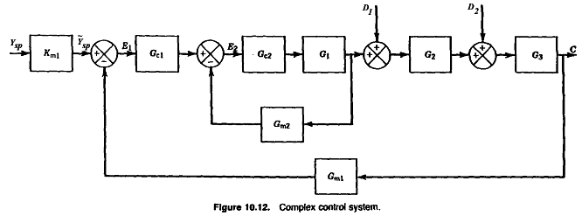
I
O
Chapter 11

Slide 18
Example

Slide 19
Chapter 11

Slide 20
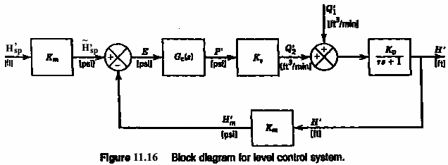
Chapter 11

Slide 21
Closed-Loop Response with P Control (Set-Point Change)

Slide 22
Closed-Loop Response with P Control (Set-Point Change)

Slide 23
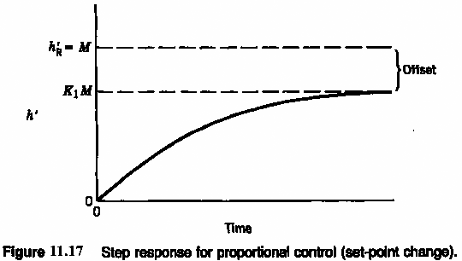
Chapter 11

Slide 24
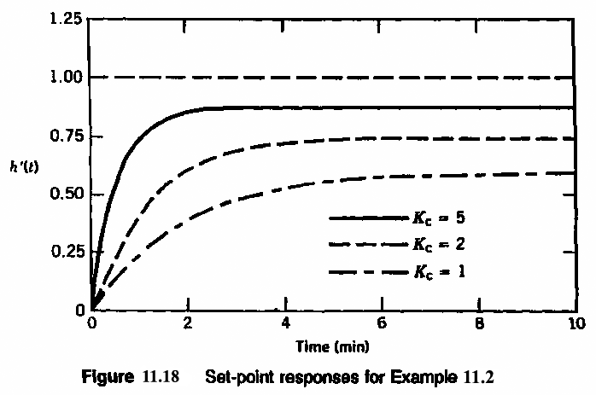
Chapter 11

Slide 25
Closed-Loop Response with P Control (Load Change)

Slide 26
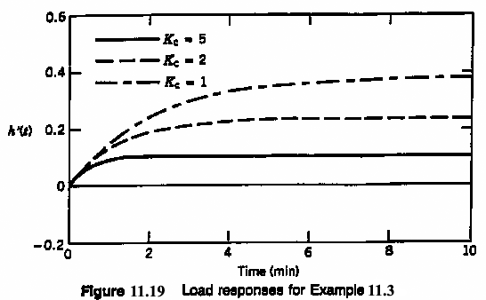
Chapter 11

Slide 27
Closed-Loop Response with PI Control (Set-Point Change)

Slide 28
Closed-Loop Response with PI Control (Load Change)

Slide 29
Closed-Loop Response with PI Control (Load Change)

Slide 30
Closed-Loop Response with PI Control (Load Change)

Slide 31
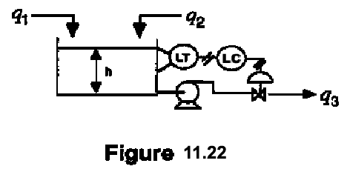
EXAMPLE 1: P.I. control of liquid level
Chapter 11
Block Diagram:

Slide 32
Assumptions
1. q₁, varies with time; q₂ is constant.
2. Constant density and x-sectional area of tank, A.
3. (for uncontrolled process)
4. The transmitter and control valve have negligible dynamics
(compared with dynamics of tank).
5. Ideal PI controller is used (direct-acting).
Chapter 11
For these assumptions, the transfer functions are:

Slide 33
The closed-loop transfer function is:
(11-68)
Substitute,
(2)
Chapter 11
Simplify,
(3)
Characteristic Equation:
(4)
Recall the standard 2nd Order Transfer Function:
(5)

Slide 34
To place Eqn. (4) in the same form as the denominator of the
T.F. in Eqn. (5), divide by K_{c}, K_{V}, K_{M} :
Comparing coefficients (5) and (6) gives:
Chapter 11
Substitute,
For 0 < ζ < 1 , closed-loop response is oscillatory. Thus
decreased degree of oscillation by increasing K_{c} or τ_{I} (for constant
K_{v}, K_{M}, and A).
unusual property of PI control of integrating system
better to use P only

